Slide 1
Building a Computer & Midterm Practice
Building a Computer, Hack CPU Interface, Midterm Topics Brainstorm and Practice Problems, Project 6 Overview

Slide 2
Lecture Outline
Building a Computer
Architecture, Fetch and Execute Cycle
Hack CPU Interface
Implementation and Operations
CSE 390B Midterm Practice Problems
Circuit Design, Writing Assembly, Tracing Assembly
Project 6 Overview
Project Tips and Workflow

Slide 3
Building a Computer
All your hardware efforts are about to pay off!
Perspective: BUILDING A COMPUTER
In Project 6, you will build Computer.hdl, the final, top-level chip in this course
For all intents and purposes, a real computer
Simplified, but organization very similar to your laptop
Project 7 onward, we will write software to make it useful

Slide 4
Von Neumann Architecture
COMPUTER
MEMORY
CPU
0
1
2
0101110011100110
1011000101010100
1110001011111100
...
Instructions
INPUT
OUTPUT
n
n+1
n+2
1100101010010101
1100100101100111
0011001010101011
...
Data
REGISTERS
CONTROL

Slide 5
Connecting the Computer: Buses
COMPUTER
MEMORY
CPU
0
1
2
0101110011100110
1011000101010100
1110001011111100
...
Instructions
INPUT
OUTPUT
n
n+1
n+2
1100101010010101
1100100101100111
0011001010101011
...
Data
REGISTERS
CONTROL
Control Bus
Address Bus
Data Bus

Slide 6
Basic CPU Loop
Repeat forever:
Fetch an instruction from the program memory
Execute that instruction

Slide 7
Fetching
Specify which instruction to read as the address input to our memory
Data output: actual bits of the instruction
MEMORY
Memory Output: Data
Instruction
D=A;JMP
0
1
2
0101110011100110
1011000101010100
1110001011111100
...
Instructions
n
n+1
n+2
1100101010010101
1100100101100111
0011001010101011
...
Data
Memory Input: Address
Instruction Address
PC
1

Slide 8
Executing
The instruction bits describe exactly “what to do”
A-instruction or C-instruction?
Which operation for the ALU?
What memory address to read? To write?
If I should jump after this instruction, and where?
Executing the instruction involves data of some kind
Accessing registers
Accessing memory

Slide 9
Combining Fetch & Execute
MEMORY
Memory Output: Data
Instruction
D=A;JMP
0
1
2
0101110011100110
1011000101010100
1110001011111100
...
Instructions
Data
245
n
n+1
n+2
1100101010010101
1100100101100111
0011001010101011
...
Data
Memory Input: Address
Instruction Address
PC
1
Data Address (From instruction or register)

Slide 10
Combining Fetch & Execute
MEMORY
Memory Output: Data
Could we implement with RAM16K.hdl?
(Hint: Think about the I/O of RAM)
Instruction
D=A;JMP
0
1
2
0101110011100110
1011000101010100
1110001011111100
...
Instructions
Data
245
n
n+1
n+2
1100101010010101
1100100101100111
0011001010101011
...
Data
Memory Input: Address
Instruction Address
PC
1
Data Address (From instruction or register)

Slide 11
Combining Fetch & Execute
MEMORY
Memory Output: Data
Could we implement with RAM16K.hdl?
No! Our memory chips only have one input and one output
Instruction
D=A;JMP
0
1
2
0101110011100110
1011000101010100
1110001011111100
...
Instructions
Data
245
n
n+1
n+2
1100101010010101
1100100101100111
0011001010101011
...
Data
Memory Input: Address
Instruction Address
PC
1
Data Address (From instruction or register)

Slide 12
Solution 1: Handling Single Input / Output
Memory Output: Data
Instruction, when fetching
Can use multiplexing to share a single input or output
MEMORY
0
1
2
0101110011100110
1011000101010100
1110001011111100
...
Instructions
DMux
Data, when executing
n
n+1
n+2
1100101010010101
1100100101100111
0011001010101011
...
Data
Memory Input: Address
Instruction Address
Mux
Data Address
Fetching vs. Executing

Slide 13
Solution 1: Fetching / Executing Separately
Fetching vs. Executing
Memory Output: Data
Instruction, when fetching
Need to store fetched instruction so it’s available during execution phase
MEMORY
Register
0
1
2
0101110011100110
1011000101010100
1110001011111100
...
Instructions
DMux
Data, when executing
n
n+1
n+2
1100101010010101
1100100101100111
0011001010101011
...
Data
Memory Input: Address
Instruction Address
Mux
Data Address
Fetching vs. Executing

Slide 14
Solution 2: Separate Memory Units
Separate instruction memory and data memory into two different chips
Each can be independently addressed, read from, written to
Pros:
Simpler to implement
Cons:
Fixed size of each partition, rather than flexible storage
Two chips → redundant circuitry

Slide 15
Lecture Outline
Building a Computer
Architecture, Fetch and Execute Cycle
Hack CPU Interface
Implementation and Operations
CSE 390B Midterm Practice Problems
Circuit Design, Writing Assembly, Tracing Assembly
Project 6 Overview
Project Tips and Workflow

Slide 16
Hack CPU
COMPUTER
ROM
(Instructions)
CPU
RAM
(Data)
instr
data out
0
1
2
010111001110
101100010101
111000101111
...
Instructions
0
1
2
100110010111
100011001111
000000000010
...
Data
addr of next instruction
REGISTERS
data in
CONTROL
INPUT
OUTPUT

Slide 17
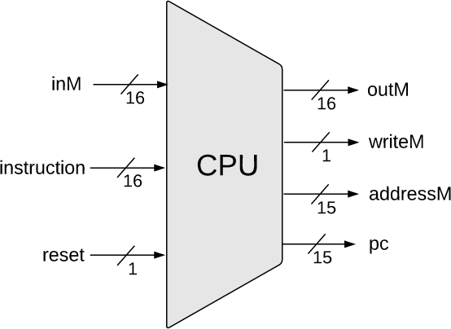
Hack CPU Interface Inputs
inM: Value coming from memory
instruction: 16-bit instruction
reset: if 1, reset the program

Slide 18
Hack CPU Interface Outputs
outM: value used to update memory if writeM is 1
writeM: if 1, update value in memory at addressM with outM
addressM: address to read from or write to in memory
pc: address of next instruction to be fetched from memory

Slide 19
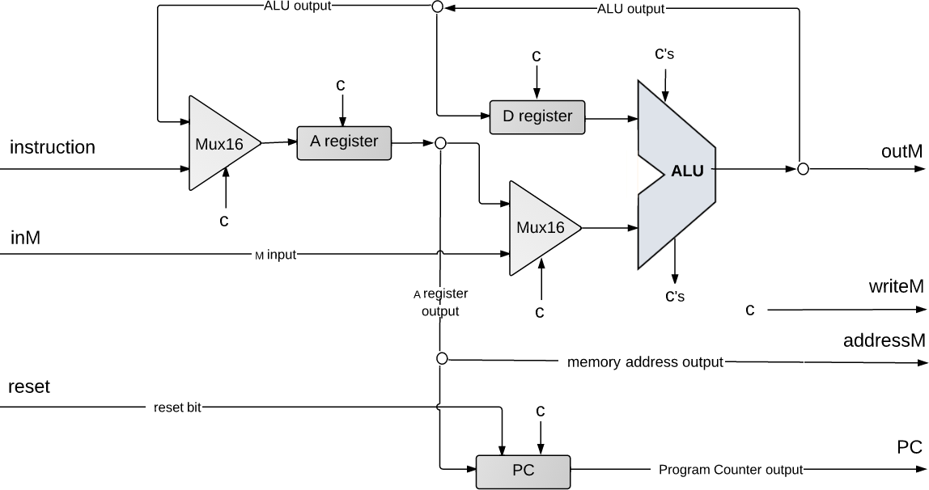
Hack CPU Implementation
pc

Slide 20
Hack CPU Implementation
(each "C" symbol represents a control bit)

Slide 21
Lecture Outline
Building a Computer
Architecture, Fetch and Execute Cycle
Hack CPU Interface
Implementation and Operations
CSE 390B Midterm Practice Problems
Circuit Design, Writing Assembly, Tracing Assembly
Project 6 Overview
Project Tips and Workflow

Slide 22
CSE 390B Midterm Topics Brainstorm
Based on what we have covered thus far in class, what are topics, concepts, questions that you might expect to show up on next week’s CSE 390B midterm?

Slide 23
CSE 390B Review Session
Practice Problems
Circuit Design, Writing Assembly, Tracing Assembly
For each problem:
Step 1: Spend 10 minutes working on the problem individually
Step 2: Spend 10 minutes discussing the problem as a group, describing tips, approaches, and test-taking strategies
Step 3: As a group, present to the class your discussion from step 2 and lead the class in working through the problem

Slide 24
Review Session Debrief
Based on your experience with this exercise, how does it inform how you approach your studying?
What resources can you utilize to help you deepen your understanding?

Slide 25
Previous CSE 390B Midterms
Four midterms from previous quarters
20sp midterm likely more difficult than midterm this quarter
Midterm from 21wi, 21sp, 22wi, 22sp are more similar to what this quarter’s midterm will look like
20sp midterm recommended to become familiar with problem types
21wi, 21sp, 22wi, and 22sp midterms recommended for practicing a timed exam
Set a timer for 60 minutes and take the exam in its entirety
Helps practice time management and simulate exam environment

Slide 26
Lecture Outline
Building a Computer
Architecture, Fetch and Execute Cycle
Hack CPU Interface
Implementation and Operations
CSE 390B Midterm Practice Problems
Circuit Design, Writing Assembly, Tracing Assembly
Project 6 Overview
Project Tips and Workflow

Slide 27
Project 6: Overview
Part I: Mock Exam Problem
Part II: Building a Computer
LoadAReg.hdl, LoadDReg.hdl (Easier)
JumpLogic.hdl (Medium)
CPU.hdl (Harder)
Computer.hdl (Easier)
Part III: Project 6 Reflection

Slide 28
Project 6, Part I: Mock Exam Problem
Your group will meet for a 30-minute session to do one mock exam problem
Your group’s mock exam problem will be emailed right before your session
Your 30-minute session will include:
Set up: 5 minutes
Mock Exam Problem: 10 minutes
Debrief & Reflection: 15 minutes
Part I Task: Submit the completed mock exam problem and complete the reflection questions

Slide 29
Project 6 Tips
CPU.hdl: We provide an overview diagram, but there are details to fill in, especially control
Draw your own detailed diagram first
Handling jumps will require a lot of logic—sketch out the cases
Textbook chapter 4 and 5 helpful for Project 6
Multi-Bit Buses: MSB to the left, LSB to the right
Important to keep in mind when taking apart the instruction
Debugging: Consult .out and .cmp files to debug, then look at internal wires in simulator
See also the “Debugging tips” section of the specification

Slide 30
Post-Lecture 11 Reminders
Project 5 due tonight (11/3) at 11:59pm
Remember to check that you have tagged the right commit
CSE 390B midterm next Thursday (11/10) during lecture
Project 6 (Mock Exam Problem & Building a Computer) released today, due in two Thursdays (11/17) at 11:59pm
Course Staff Support
Eric has office hours in CSE2 153 today after lecture
Post your questions on the Ed discussion board

